Slide 1










Sentiment Analysis using Deep learning
CREATED BY
SHALINI.J
3ʳᵈ year – CSE
Reg . No.:912321104039
SACS M.A.V.M.M Engineering college , Madurai.

Slide 2

Outline
Problem statement
Proposed system/solution
System development approaches
Algorithm and deployment
Result
Conclusion
Reference

Slide 3
Problem statement
The objective of this project is to develop a deep learning model for sentiment analysis that accurately classifies the sentiment of text data into predefined categories such as positive, negative, or neutral. The model should be able to handle various types of text data, including short social media posts, longer product reviews, and customer feedback.

Slide 4
Proposed system / solution
1.Data Processing :
Prepare your dataset by tokenizing text, removing stopwords, and encoding labels (positive/negative sentiment).
. Convert words into dense vectors using techniques like word embeddings (e.g., Word2Vec, GloVe) or contextual embeddings (e.g., ELMo, BERT).
RNN-based Approach: Utilize LSTM or GRU cells to capture sequential information in the text.
Transformer-based Approach: Employ models like BERT or GPT, which can capture contextual relationships in the text more effectively.
2.Embedding Layer:
3.Model Architecture :
4

Slide 5
Proposed system /solution (contd….)
Train the model on a labeled dataset using techniques like mini-batch stochastic gradient descent or Adam optimizer.
Fine-tune pre-trained models (e.g., BERT) on your specific sentiment analysis task to improve performance further.
Assess the model’s performance on a separate validation or test set to ensure it generalizes well to unseen data.
4.Training:
5.Fine Tuning :
6.Evaluation:
5

Slide 6

Proposed system/solution (contd….)
7.Monitoring and Updating :
Continuously monitor the model’s performance in production and update it periodically with new data to maintain its effectiveness over time

Slide 7
System Development Approach
Hardware requirements:
1.GPU (Graphics Processing Unit):
GPU acceleration. NVIDIA GPUs are commonly used due to their compatibility frameworks like TensorFlow and PyTorch.
While not as crucial as GPU for training deep learning models, a powerful CPU can still speed up certain aspects of the process, such as data preprocessing and model evaluation.
. Sufficient RAM is essential, especially when working with large datasets.
2.CPU (Central processing unit):
3.RAM (Random Access Memory):

Slide 8
System Development Approach (Contd….)
4.Storage:
You need enough storage space to store the dataset, trained models, and any intermediate results. SSDs are preferred over HDDs for faster read/write speeds.
For very large datasets or computationally intensive tasks, using a cluster of machines or cloud computing resources can provide the necessary scalability and performance.
5.Cluster/Cloud Computing Resources:
6.Optimization Technique:
Distributed training, mixed precision training, and model pruning can help improve training efficiency and reduce hardware requirements.

Slide 9
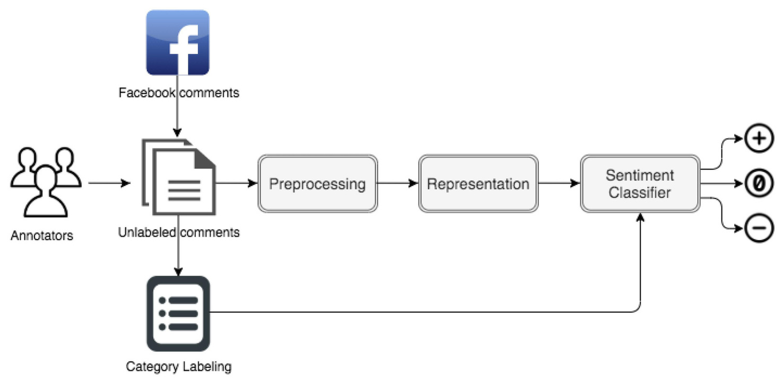
System Development Approach (Contd….)
Software requirements:
Tools and Frameworks:
Popular deep learning libraries like TensorFlow, PyTorch, or Keras can be used for model development.Cloud platforms like Google Colab or provide environments for training and deploying deep learning models.

Slide 10
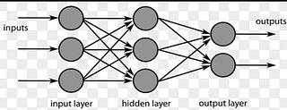
Algorithm and Deployment
Algorithm:
1.Load the dataset
2.Preprocesses the data by padding sequences to a fixed length
3.Builds a sequential model with an embedding layer
4.Complies the model
5.Trains the model on the training data
6.Evaluates the model on the test data
7.Prints the test accuracy

Slide 11
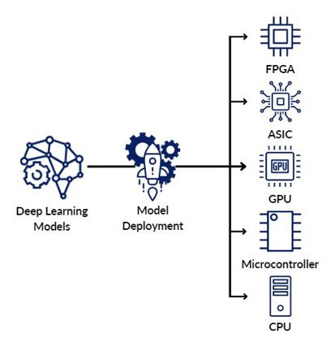
Algorithm and Deployment (contd….)
Deployment:
Deployment can be done on various platforms, including cloud servers, edge devices.
For deployment on cloud servers,trained model is hosted on a cloud accessed via APIs.
Deployment on edge devices involves optimizing the model for reducing model size.
1
11

Slide 12
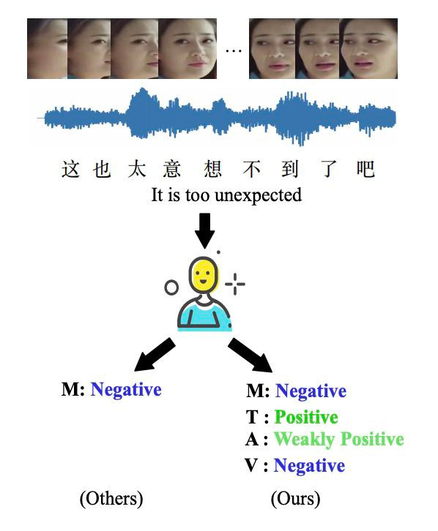
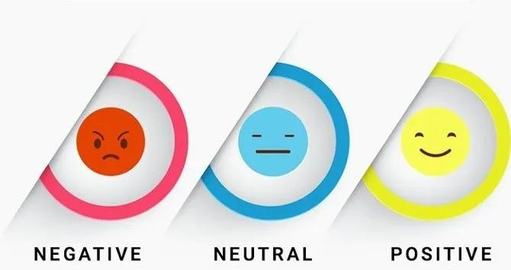
Data set state
Kagglelink:(“https://www.kaggle.com/datasets/nicapotato/womens-ecommerce-clothing-reviews?resource=download”)

Slide 13
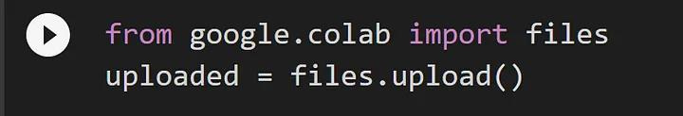
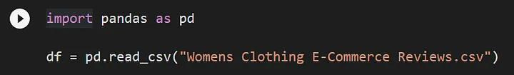
Program
1.Upload the CSV file
2. Once the file has finished uploading, you can use the pd.read_csv() command to read the file into a pandas data frame.

Slide 14

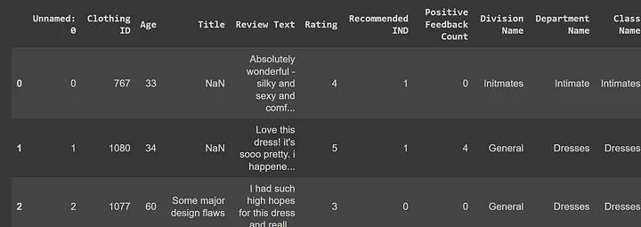
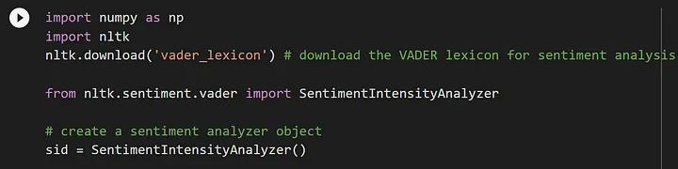
3. Next, we can use the df.head(10) command to display the first 10 rows of the data frame.
Output
4. I want to do sentiment analysis on the “Review Text Column”. First I will import the necessary libraries to perform sentiment analysis.

Slide 15
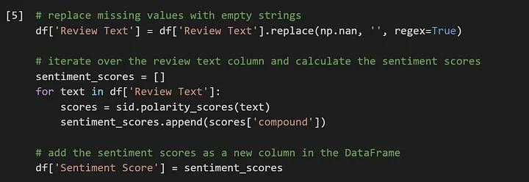
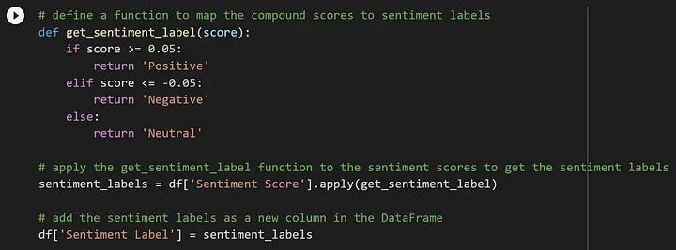
5. In the next step, we will prepare the ‘Review Text’ column of our dataset for sentiment analysis and calculate sentiment scores using the below code.
6. After calculating the sentiment scores for each review in the ‘Review Text’ column, we define a function called “get_sentiment_label” to map the sentiment scores to three sentiment labels: “Positive”, “Negative”, and “Neutral” using the below code.

Slide 16
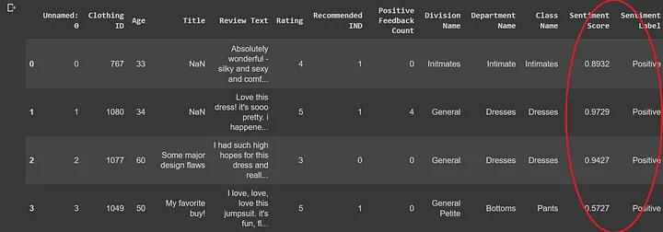
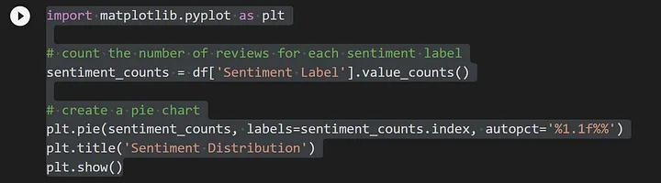
7. The code df.head(10) will display the first 10 rows of the DataFrame df with newly added columns ‘Sentiment Score’ and ‘Sentiment Label’
Data Visualization
1.Now we are creating a pie chart to visualize the distribution of sentiment labels in the dataset with the below code.

Slide 17
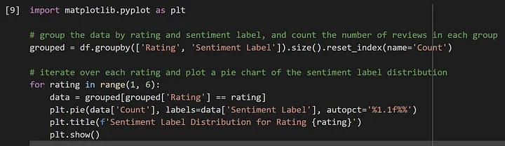
2. Let’s find How Sentiment is distributed for each rating with the below code.
3.We can also plot the sentiment label against each review rating. This allows us to see if there is any correlation between sentiment and rating scores. We can use the below code to create this plot.

Slide 18
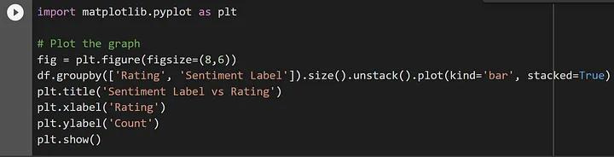
In conclusion, sentiment analysis can provide valuable insights into customer reviews and feedback. By using tools like the VADER lexicon and Python libraries like pandas and matplotlib, we can perform sentiment analysis on text data and visualize the sentiment distribution.

Slide 19
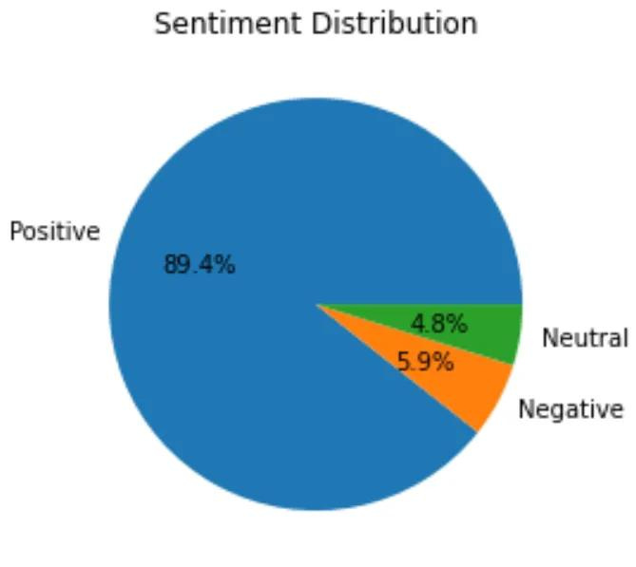
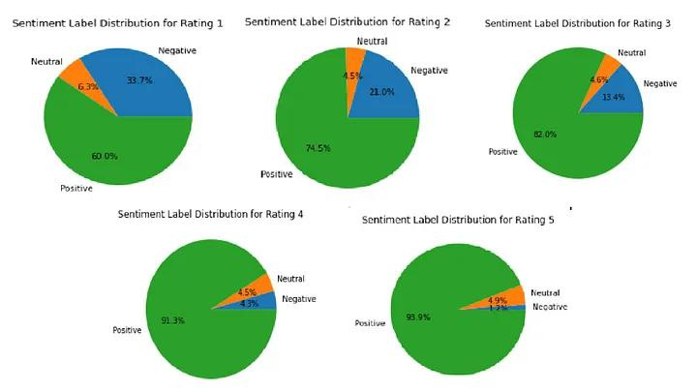
Result

Slide 20
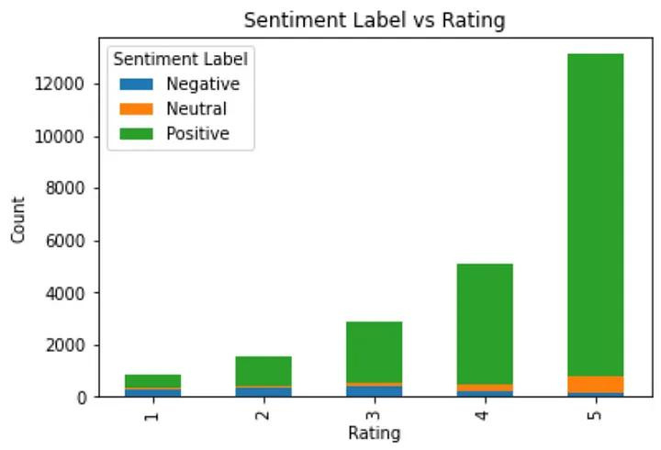
Result (contd….)

Slide 21
Conclusion:
In conclusion, sentiment analysis utilizing deep learning techniques offers a robust and efficient approach to discerning emotions from text data. As deep learning continues to advance, sentiment analysis will likely become even more precise and adaptable to various contexts, enhancing our understanding of human emotions in textual data.

Slide 22
Reference :
https://www.tensorflow.org/
https://numpy.org/
https://scikit-learn.org/stable/
https://keras.io/
https://matplotlib.org/
https://www.kaggle.com/datasets/nicapotato/womens-ecommerce-clothing-reviews?resource=download

Slide 23


